Slide 1
Gesturama
(Gesture Recognition System)
Submitted By:
Gaurav Birdi (01918002718)
Md Omer (03018002718)
Sachin Sharma (04418002718)
Prakhar Katiyar (40118002718)
Submitted To:
Ms. Upasna Joshi

Slide 2
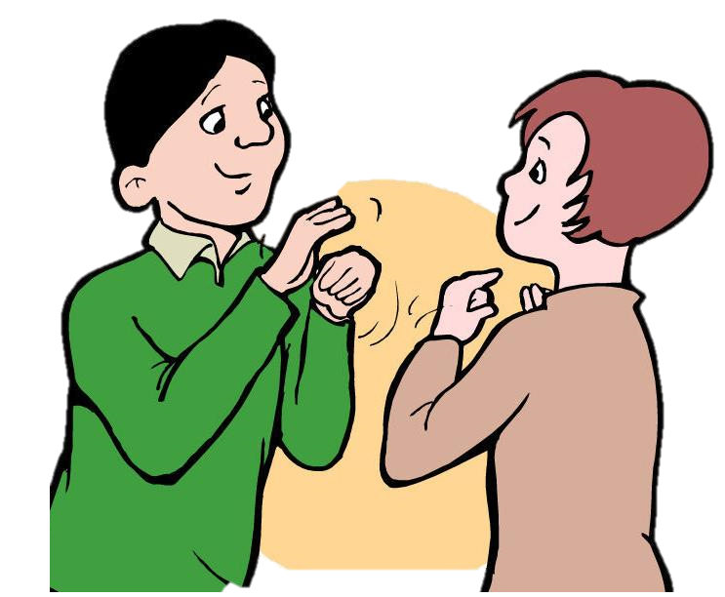
INTRODUCTION
According to World Health Organization (WHO), about 285 million people are visually impaired worldwide, 466 million people have disabling hearing loss and 1 million people are dumb.
These specially aided people are discriminated and mostly suffer in various sectors of our society.
Communication is the basis of human progress, and an obstacle for these specially abled people.

Slide 3
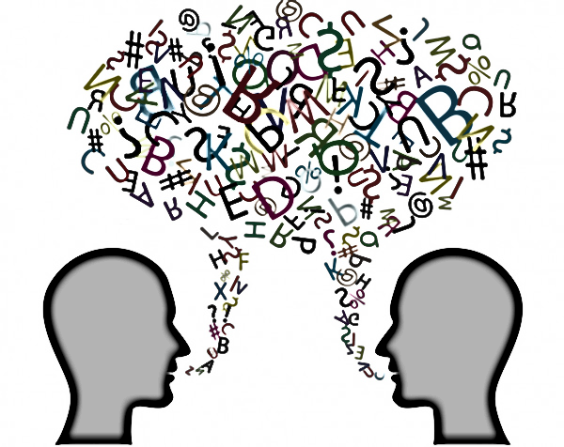
CONTINUED…
Many of these people are not even exposed to sign languages and it is observed that it gives a great relief on a psychological level, when they find out about signing to connect themselves with others by expressing their love or emotions.
Deaf and dumb people use sign language as their primary means to express their thoughts and ideas to the people around them with different hand and body gestures.
Nowadays, the evolution of technology and the increasing use of computers gave the opportunity for developing new methods of education of deaf individuals and sign language interpreters.
In this project we aspire to help these specially-abled people by developing a software which could act as a communication bridge between these two sections of the society..

Slide 4
PROBLEM STATEMENT
Communication in addition with gestures is considered to be more captivating than just verbal communication. Gestures are a more effective way of communication for not only people in day to day life but they also provide an easy and efficient way for the people having difficulty in communication due to their disability. So, knowing the various gestures or at least being able to recognize these gesture leads to better communication between these people. Our goal is to make a system that can recognize the gesture for these people and solving communication problems in the society some of which are mentioned below :
Deaf-mute people face these communication gap problems in their day-to-day life.
They often suffer while communicating their feelings.
The normal people generally are unaware/uneducated about sign language, so even if they intend on helping the specially-abled they are mostly unable to understand.

Slide 5
OBJECTIVE
Our Objective is to create a software which can easily detect the hand gestures using latest developing technology.
• Our software will help the deaf-mute community that suffers because of this communication gap.
• By using our software, it will be easier for them in conveying their ideas/messages.
• As the normal people generally are unaware/uneducated about sign language, so even if they intend on helping the specially-abled they will be able to do that with the help of our software.
• The Software will be easy to use, sustainable and user friendly.

Slide 6
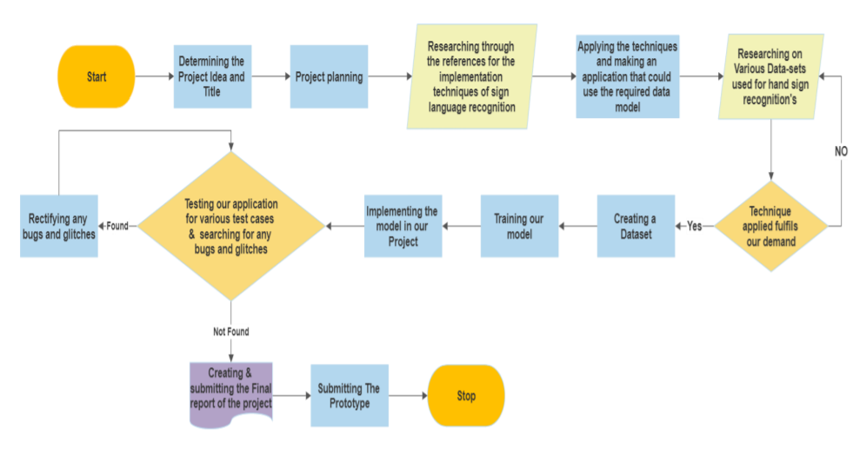
METHODOLOGY

Slide 7
IMPACT
This project can help in various different sectors, some of the applications are:
• The dependency of specially-abled community towards others will be minimized and it will lead towards less human resourcefulness.
• The participation of that community will increase in certain sectors of society due to the ease of interpretation of their ideology.
• There will be a much stable balance between the two sectors of society.
• The community will be able to utilize every opportunity just like everyone else in the society.

Slide 8
RESOURCE REQUIREMENT
HARDWARE REQUIREMENTS
PC/Laptop with Webcam connectivity
Processor: Core 2 duo and above
Processor Speed: 2.4 GHz and up
System Memory: 1GB recommended
Hard Disk: 100GB
1GB of RAM (Minimum)
Monitor: SVGA Color 14”
Keyboard: 104 US keys
Mouse: Trackball
USB ports for external camera attachment
HD Webcam/External Camera
Higher configurations are also supported
SOFTWARE REQUIREMENTS
One of these Text Editors
Pycharm
Jupyter Notebook
Notepad
PythonIDE
Python 3.7 and following libraries –
OpenCV
TensorFlow
Mediapipe
Cvzone
Microsoft Office.
Keras Dataset
Web Browser- Chrome/ Firefox
OS- Windows 10

Slide 9
LITERATURE SURVEY
S.No. | Title | Objective | Key Points | Published By
1 | Real time hand gesture recognition system for dynamic applications | The research effort centralizes on the efforts of implementing an application that employs computer vision algorithms and gesture recognition techniques which in turn results in developing a low cost interface device for interacting with objects in virtual environment using hand gestures. | • Hand gesture recognition • Interacting with virtual objects • Working with virtual environment • Hand tracking | Rautaray(IIT Allahabad)[1]
2 | Translation of Sign Language for Deaf and Dumb People | This project’s objective is to analyze and translate the sign language that is hand gestures into text and voice. | • Sign • Language • SVM • Text • Voice | Suthagar S.[2]

Slide 10
S.No | Title | Objective | Key Points | Published By
3 | Hand Gesture Recognition System for Deaf and Dumb | An in-depth literature review has been carried out to look at the present state of data relating to Hand gesture recognition systems that explicitly focused on the vision-based technique for sign language detection | Artificial mouth •Non-vision based technique • Sign language detection • Speech impaired people • Vision-based technique | Shareef[3]
4 | A Novel Technique for Speech Recognition and Visualization Based Mobile Application to Support Two Way Communication Between Deaf-Mute and Normal People | In this work Mel- frequency cepstral coefficients (MFCC) based features are extracted for each training and testing sample of Deaf-mute speech. | • MFCC • HTK • V2M application | Yousaf[4]

Slide 11
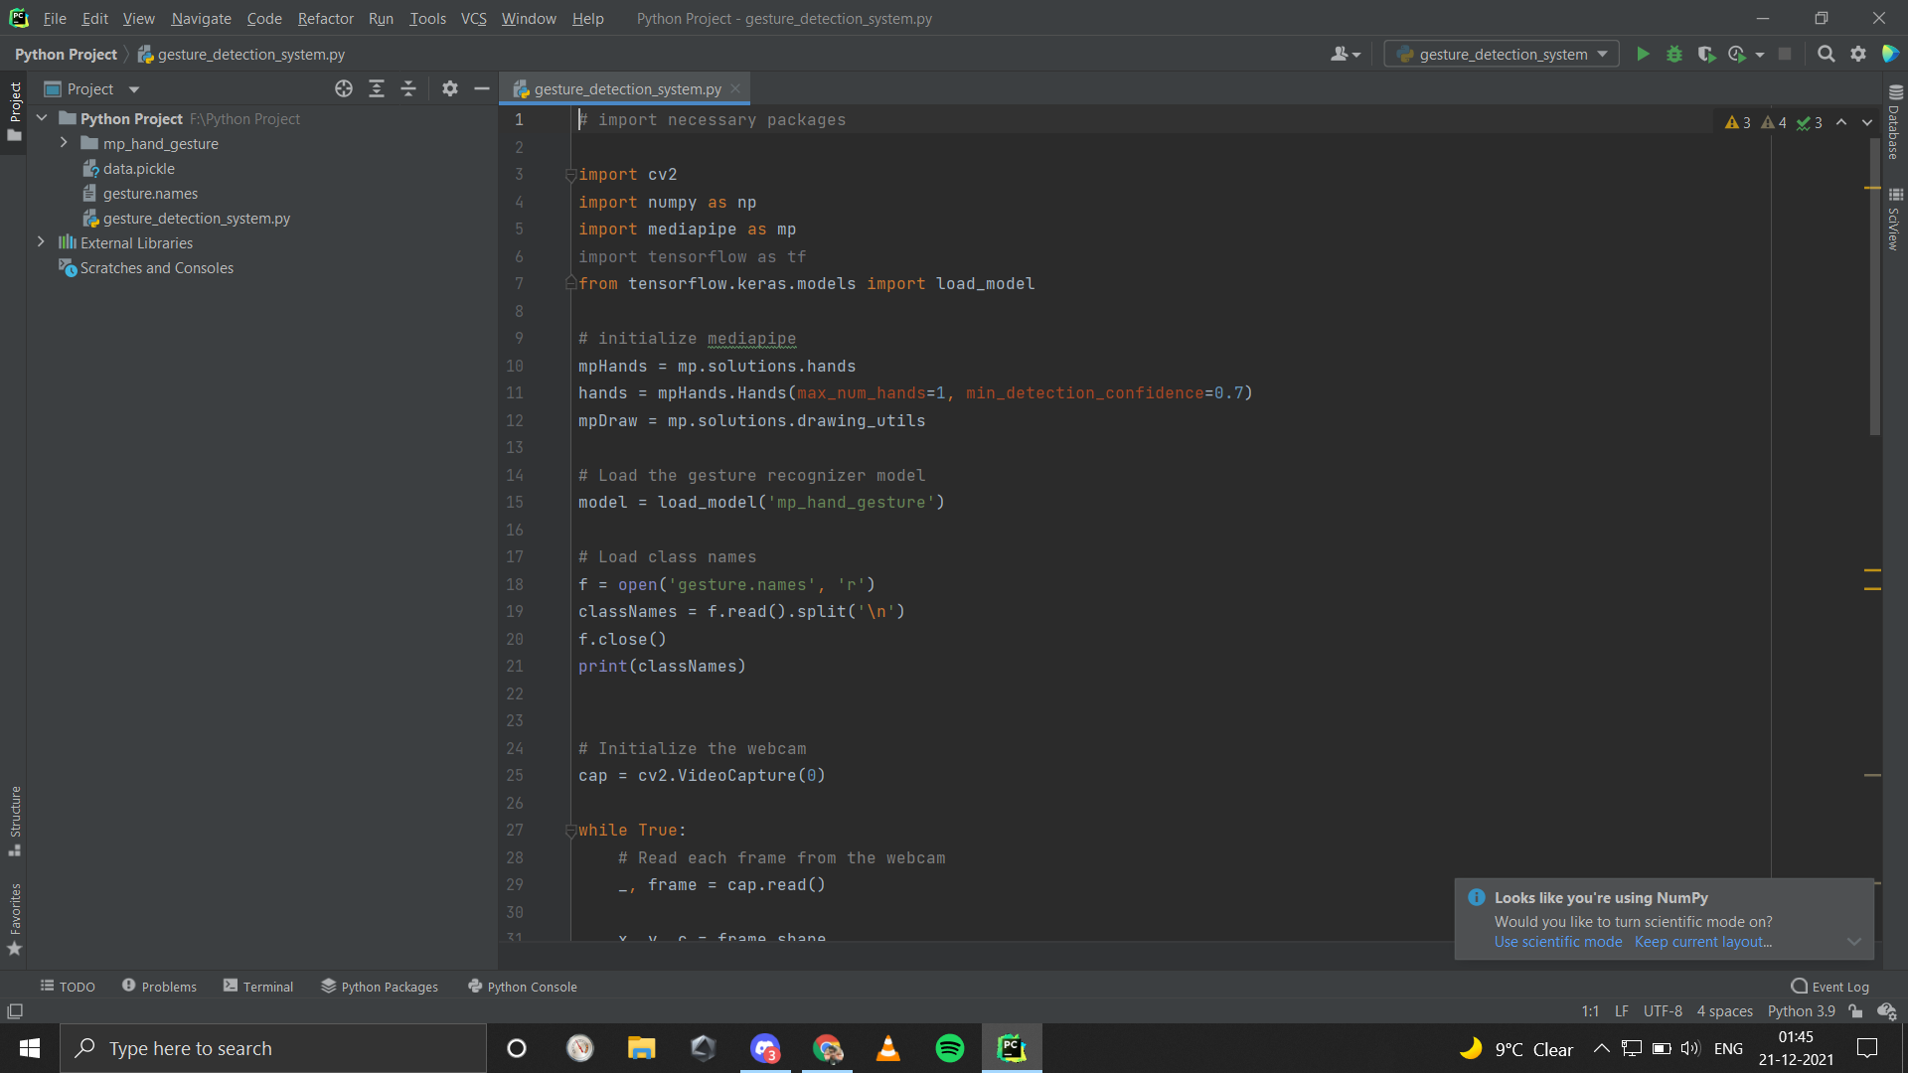
RUNNING MODULE
Importing The Necessary Packages:
Initializing The Models:

Slide 12
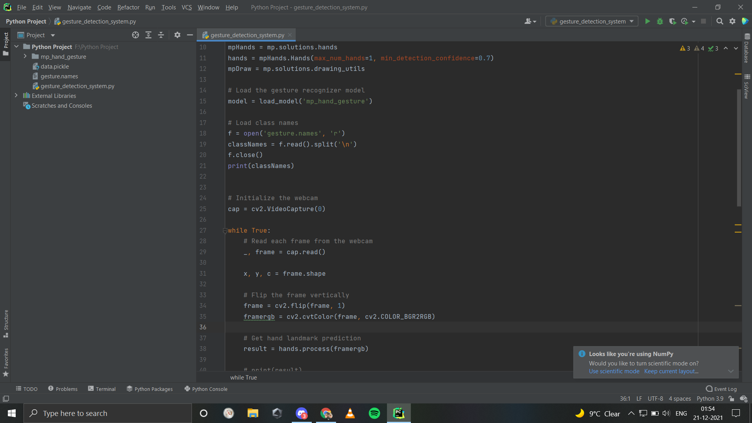
Capturing Frames From Webcam Using OpenCV:

Slide 13
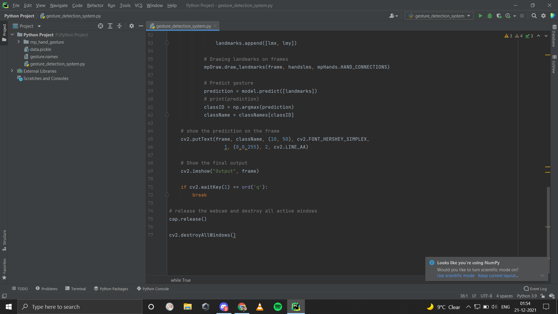
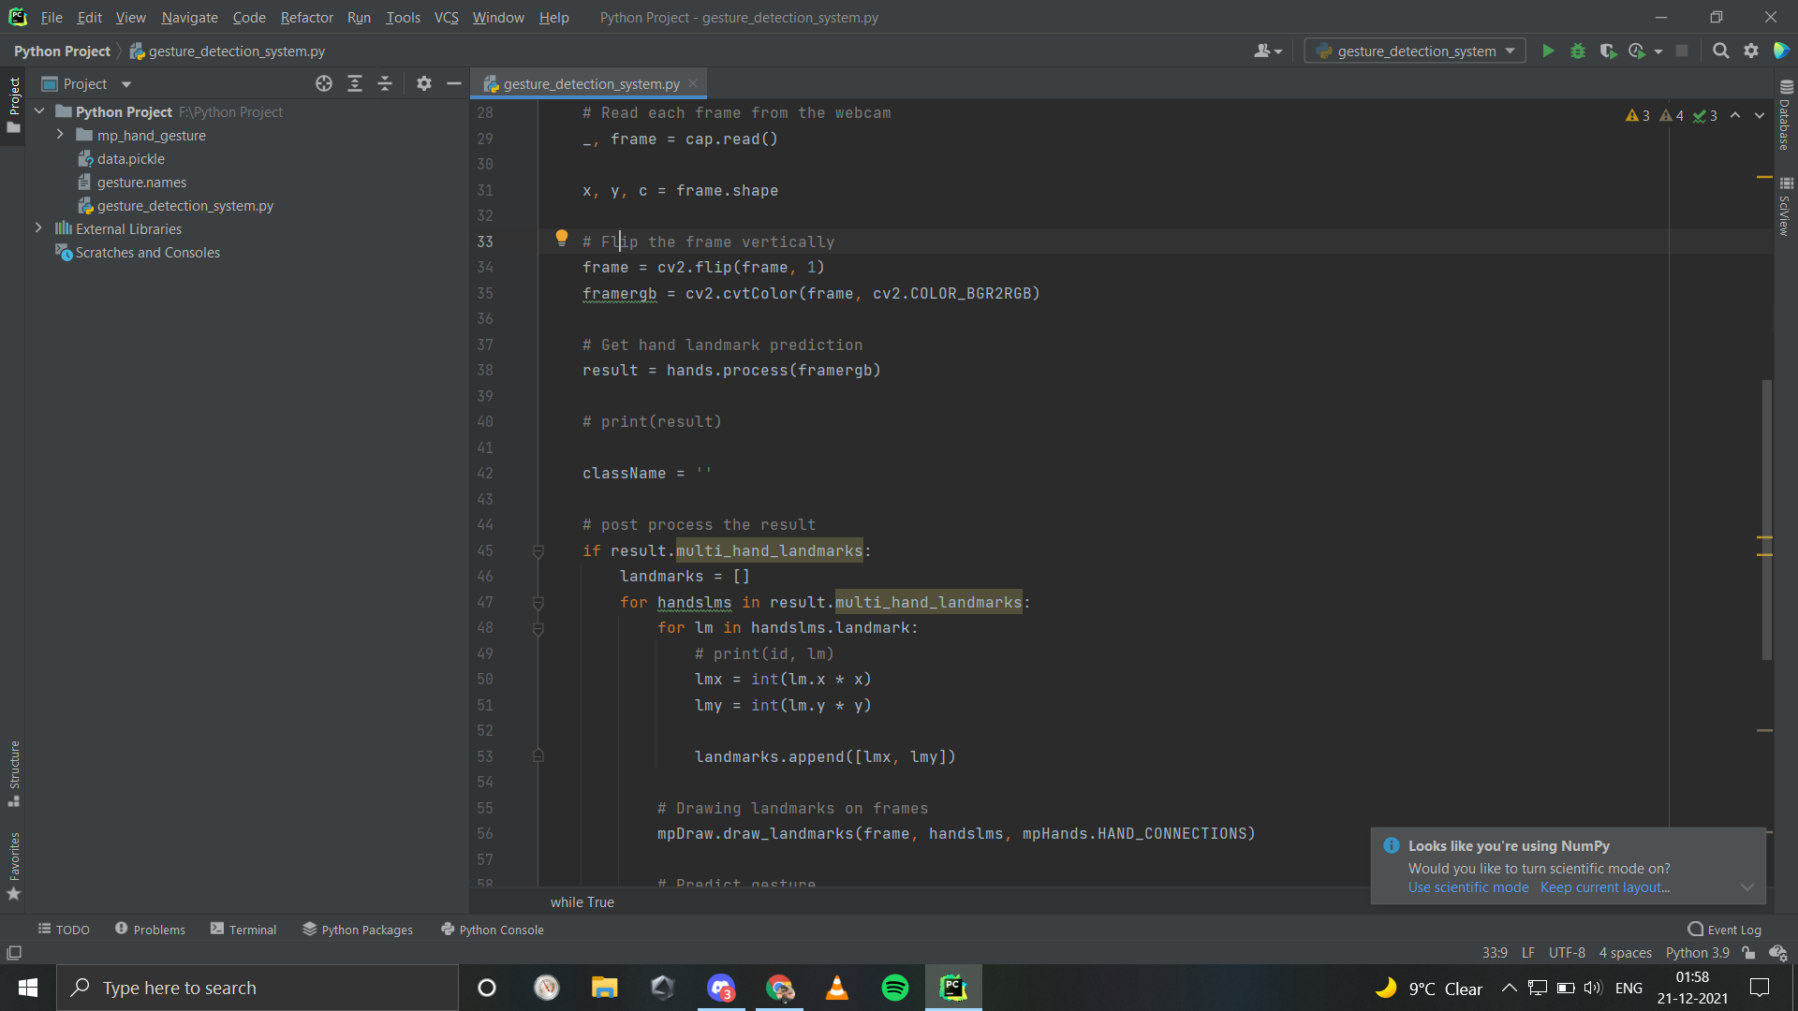
Detecting Hand Key points:

Slide 14
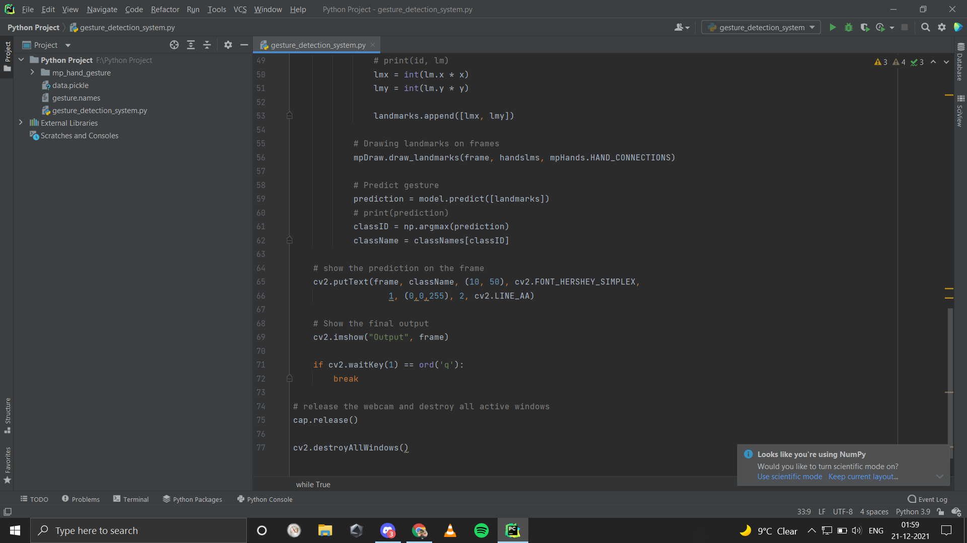
Recognize Hand Gestures:

Slide 15
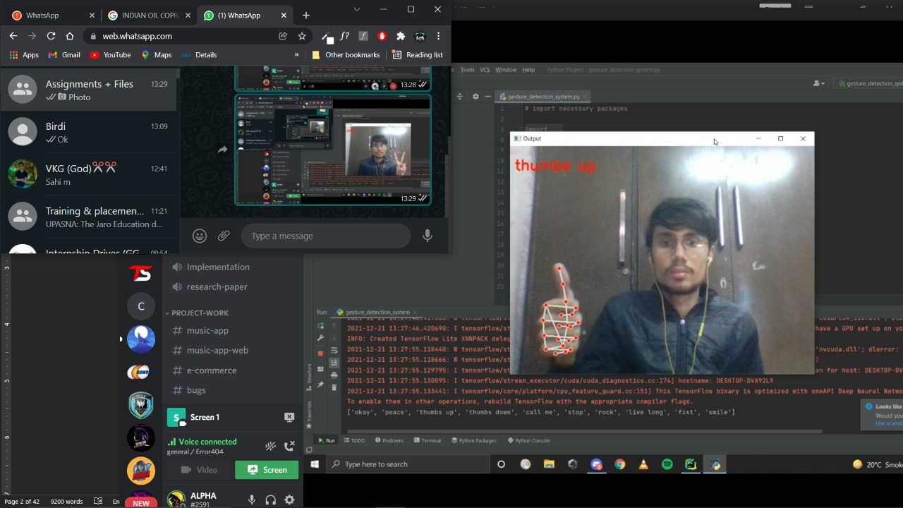
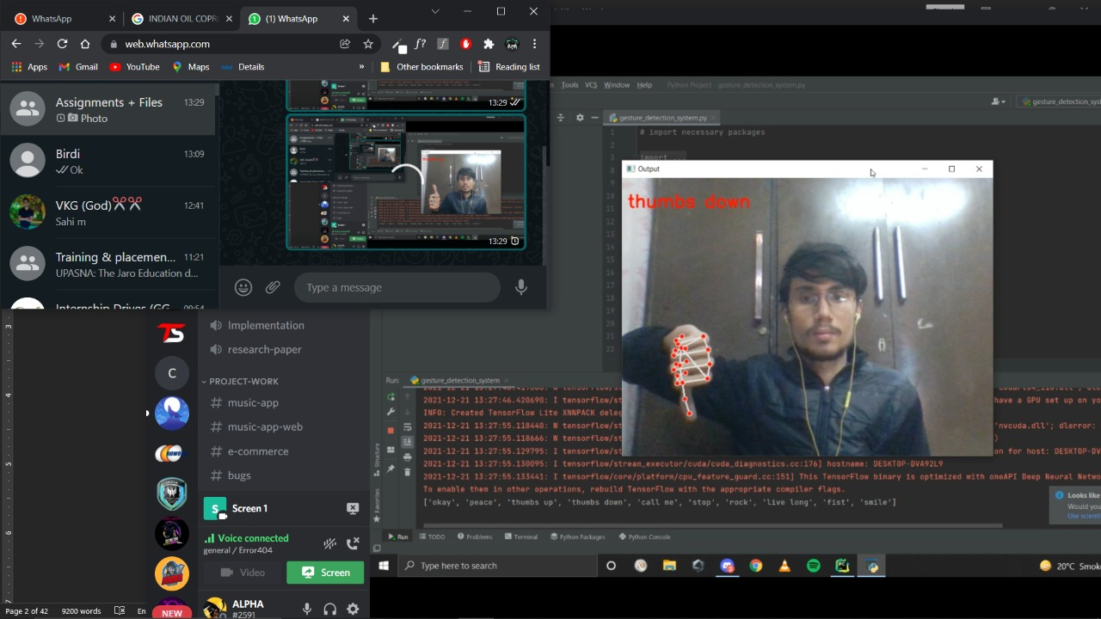
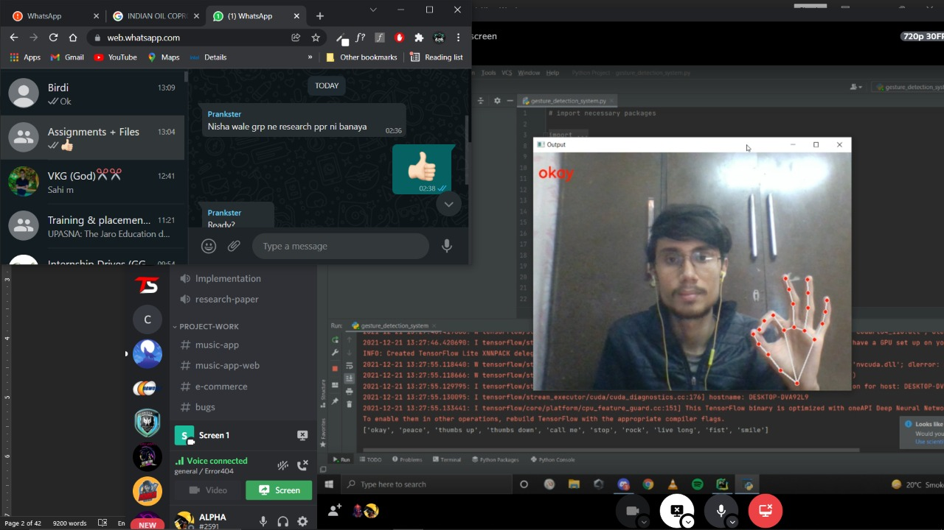
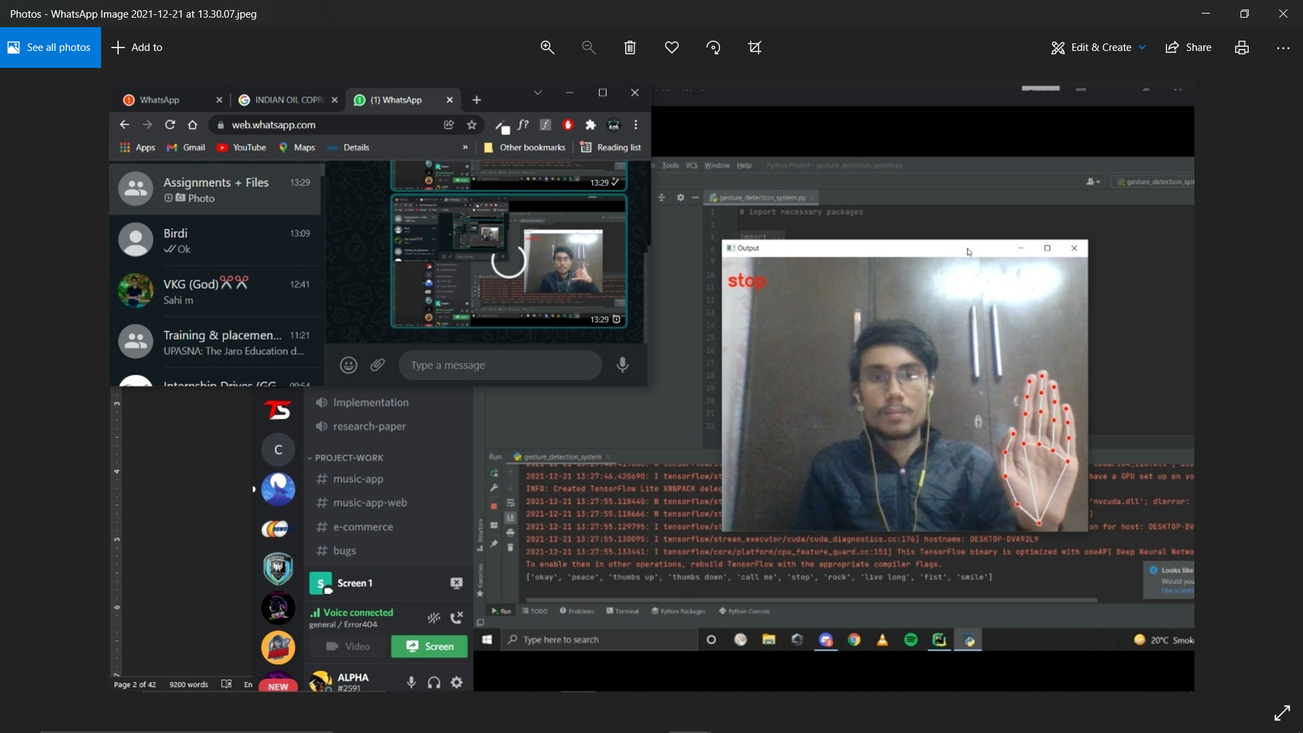
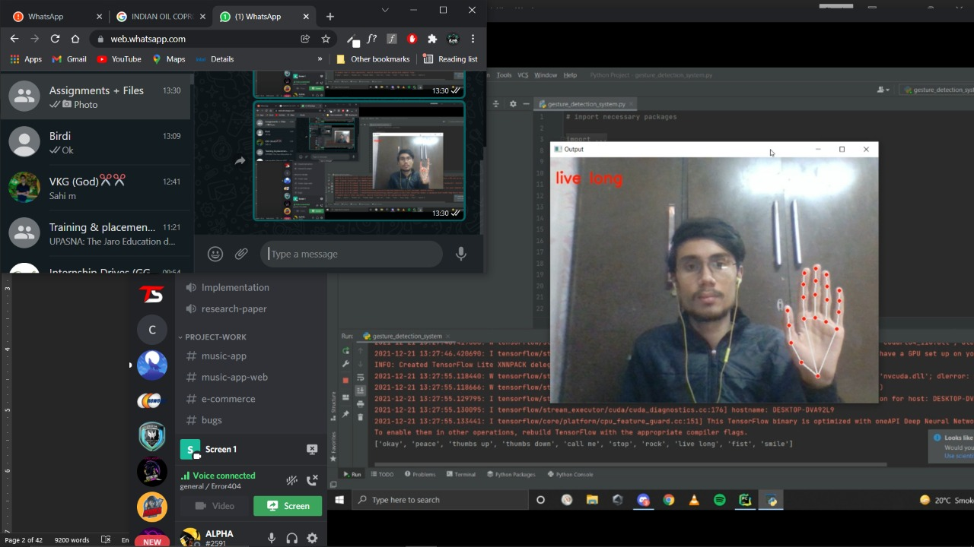
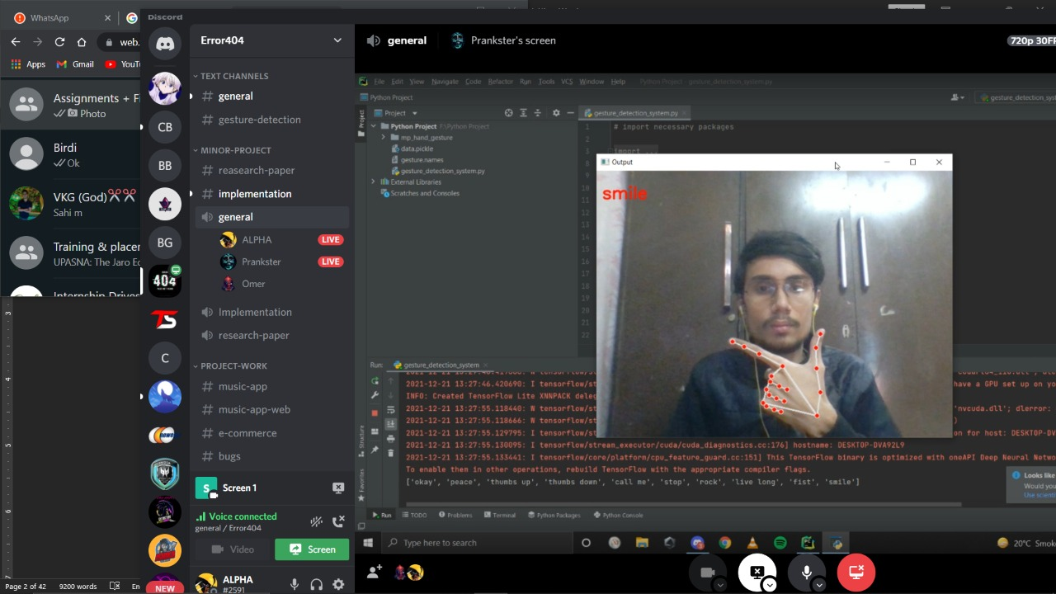
OUTPUTS:

Slide 16
REFERENCES
[1] Siddharth S. Rautaray, Anupam Agrawal (IIT, Allahabad, 2012): Real time hand gesture recognition system for dynamic applications
[2] Suthagar S., K. S. Tamilselvan, P. Balakumar, B. Rajalakshmi, C. Roshini (2020): Translation of Sign Language for Deaf and Dumb People
[3] Syed Raquib Shareef, Mohammed Mannan Hussain(Muffakham Jah College of Engineering and Technology, Hyderabad, Telangana-500034, India, 2020): Hand Gesture Recognition System for Deaf and Dumb
[4] Kanwal Yousaf, Zahid Mehmood, Tanzila Saba, Amjad Rehman, Muhammad Rashid, Muhammad Altaf, and Zhang Shuguang(2018): A Novel Technique for Speech Recognition and Visualization Based Mobile Application to Support Two-Way Communication Between Deaf-Mute and Normal People
https://google.github.io/mediapipe/getting_started/python.html
https://www.tensorflow.org/learn
https://www.geeksforgeeks.org/python-programming-language/
https://keras.io/api/datasets/
https://www.jetbrains.com/pycharm/
http://pythonhow.com/
http://opencv.org/

Slide 17
Thank You!!

